Slide 1
Create Order

Slide 2

Manage Order
Create New Order

Slide 3
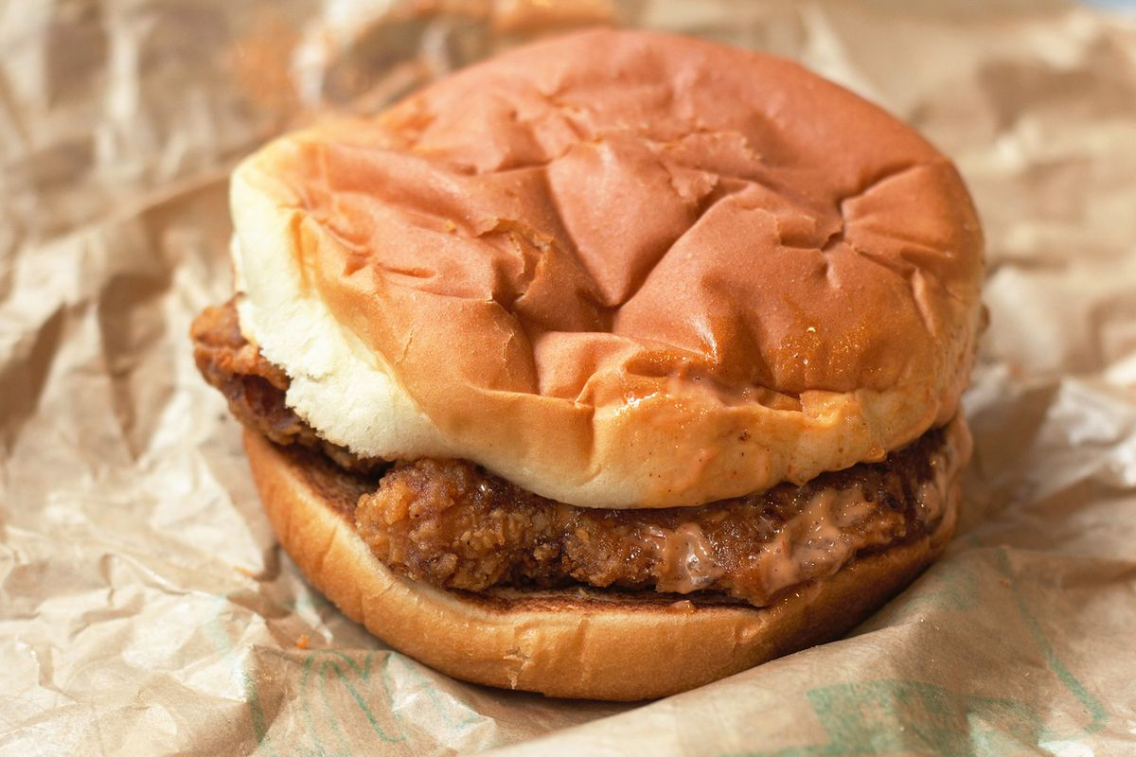
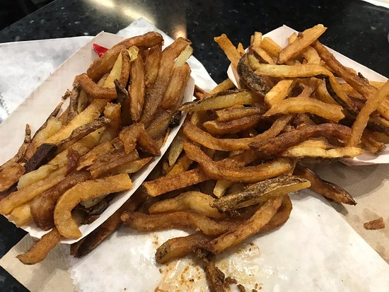
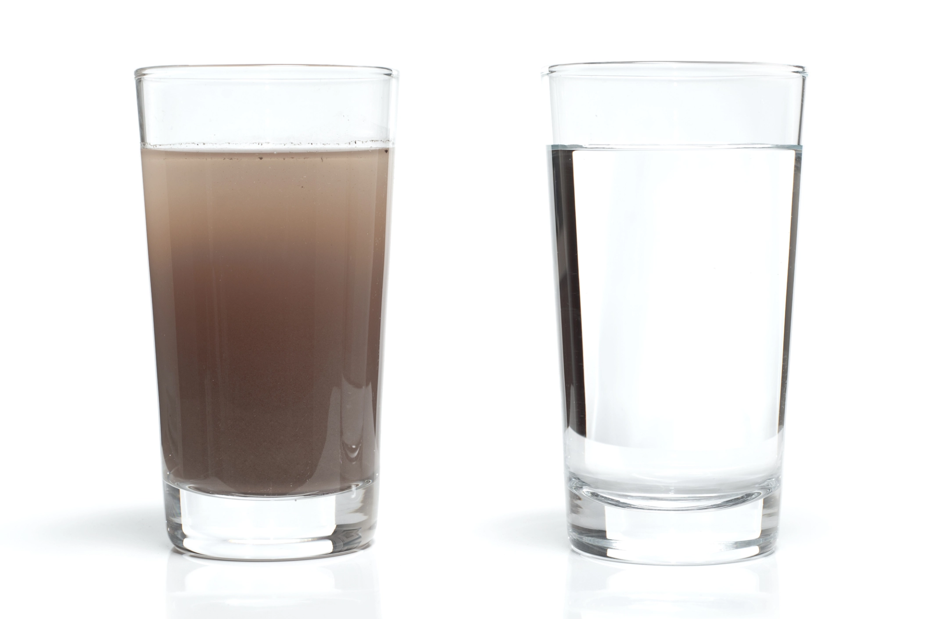
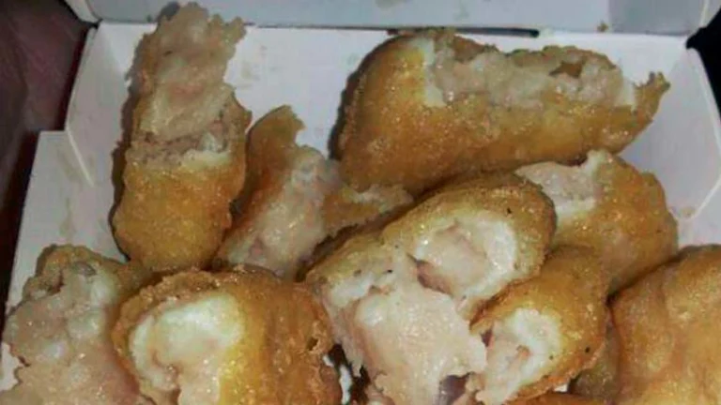
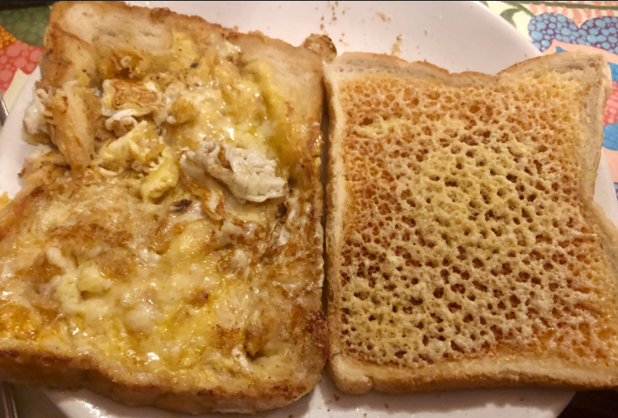
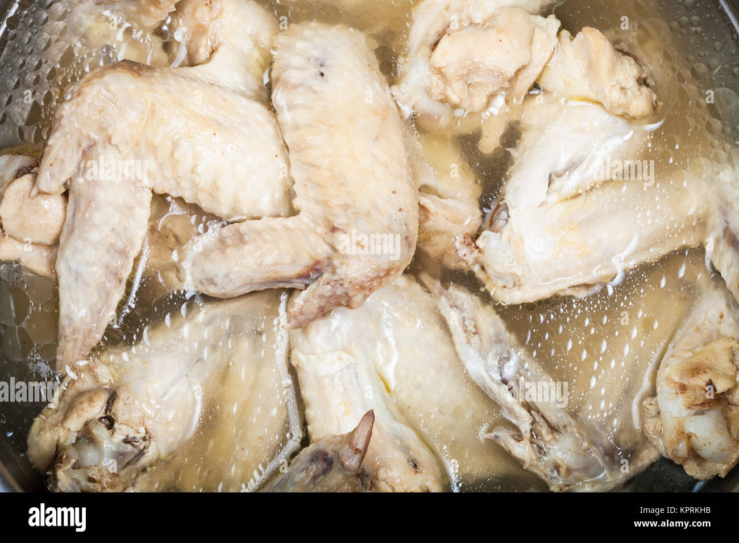
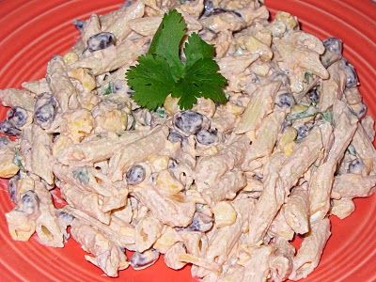
Foods
Sides
Drinks
Order : 01
----------------------
-
-
-
-
-
-
Total:
Chick san
Last Friday’s fries
Seasoned water
Walter’s nuggies
Holy bread
Dihydrogen Monoxide
Wang Bang
Mack
Cancel Order
Edit Order
Finish Order

Slide 4
Foods
Sides
Drinks
Order : 01
---------------------------------------------
- Walter’s nuggies
-
-
-
-
-
Total: 335.86
14
Chick san
Last Friday’s fries
Seasoned water
Walter’s nuggies
Holy bread
Dihydrogen Monoxide
Wang Bang
Mack
Cancel Order
Edit Order
Finish Order

Slide 5
Foods
Sides
Walter’s nuggies Notes
---------------------------------------------
Medium rare
Chick san
Last Friday’s fries
Seasoned water
Walter’s nuggies
Holy bread
Dihydrogen Monoxide
Cancel
Done
Wang Bang
Mack
Cancel Order
Edit Order
Finish Order

Slide 6
Foods
Sides
Order : 01
----------------------
- Walter’s nuggies
-
-
-
-
-
Total: 335.86
14
Chick san
Last Friday’s fries
Seasoned water
Walter’s nuggies
Holy bread
Dihydrogen Monoxide
Wang Bang
Mack
Cancel Order
Edit Order
Finish Order

Slide 7
Order : 01
------------------------------------------------------------------------
- Walter’s nuggies 14 : Medium Rare
-
-
-
-
-
-
-
Total: 335.86
Name:
Edward Rodgers
Back
Submit Order

Slide 8
Manage Order
Create New Order

Slide 9
Foods
Sides
Drinks
Order : 02
----------------------
-
-
-
-
-
-
Total:
Chick san
Last Friday’s fries
Seasoned water
Walter’s nuggies
Holy bread
Dihydrogen Monoxide
Wang Bang
Mack
Cancel Order
Edit Order
Submit Order

Slide 10
Chef Display

Slide 11
Order : 01
Order : 02
Order : 03
Order : 04
14 Walter’s Nuggies
Medium Rare
DONE
DONE
DONE
DONE

Slide 12
Order : 02
Order : 03
Order : 04
Order : 05
DONE
DONE
DONE
DONE

Slide 13
Manage Order

Slide 14
Manage Order
Create New Order

